Slide 1
Privacy and wearables: Addressing Pitfalls of data sharing with insurance providers
Cathy DiGennaro, Jose Luis Lopez, Celia Stafford
Notes:
Remote patient monitoring in the form of various wearables provides a huge opportunity for clinicians to better and more proactively manage their patients health. It also allows for population level analysis which with quickly advancing machine learning techniques will mean that we can provide individualized recommendations and detect conditions which may spiral out of control faster.

Slide 2
TEMPLATE TIPS
This agenda is built using a table. To add a row, either press the tab key, or select the table, then in the top ribbon go to layout > insert below.
To delete a row, simply use the backspace key.
Don’t forget to centre the table to the slide by selecting the table then going to layout > align middle.
01 | The Problem
02 | The Model
03 | The Proposed Policies
04 | The Future of the Model
05 | The Q&A

Slide 3
Requirements
For an audience of system dynamicists, a live 5 minute presentation plus 5 minute Q&A session which must include​
A description of the model & its feedback structure​
A discussion of the proposed policies & their impacts​
A discussion of how your solution can be further developed to answer some of the broader questions in your chosen prompt, i.e., beyond the research question you chose to focus on.

Slide 4
the tradeoff between privacy concerns and health gains at a population level
Wearables have the potential to improve population health, but are accompanied by several pitfalls:
Privacy concerns
Ethical implications related to fairness in insurance markets
Continued use of the wearables over time
Equity and access concerns around who can even get them
Cost – who will pay for them anyway?
Notes:
An obvious corollary to the existence of and use of wearables by providers, is the sharing of that data with insurance companies. Our group is interested in the way that this data sharing with providers alone, but more importantly with insurers, could lead to the unintended consequence of broad de-adoption due to mistrust in what the data are being used for and general privacy concerns, especially when worries about “big brother” are already rampant.

Slide 5
The Model
Describe the model and its feedback structure, either the figure from the policy brief or a slightly more complex one

Slide 6
Notes:
we modeled the different stages of “adoption” of data sharing with insurance companies, those who do and do not share and who refuse to use wearables entirely, baseline premiums and the way that premiums change with the discounts an insurance company could use as incentives, population health, and trust in how insurance companies use these data. We show for example a reinforcing feedback loop wherein decreased trust leads to lower willingness to share data, resulting in lower attractiveness of the wearables as the data they are built on is more sparse, further decreasing trust.

Slide 8
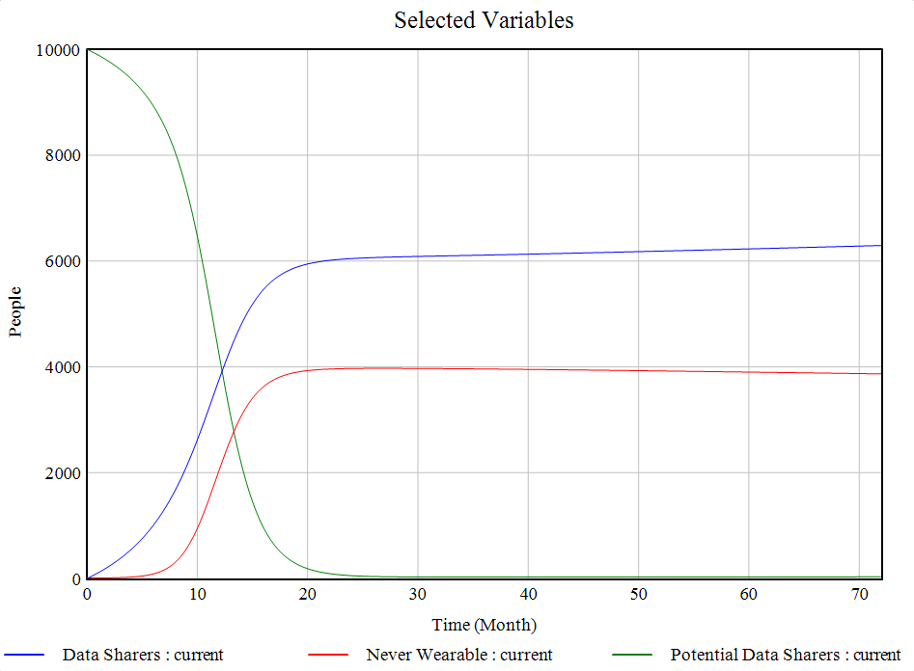
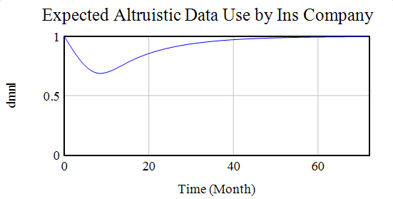
Initial results
Quite sensitive to initial accuracy of the algorithm ad price sensitivity and the time to realize health gains
Large holdout population (decisions are durable)

Slide 9
Potential policies to increase trust
Regulatory interventions
Intermittent data collection
Health care overhaul
E.g., disallowing private insurance companies from using personal health tracking data at an individual level
E.g., disallowing high-frequency personally identifiable data storage
Medicare for All (and similar proposals) obviate the risk of private insurance companies benefitting from personally identifiable data.
- Would be subject to new concerns related to trust in the government entity that stores the data
Notes:
Insurance companies should carefully consider how they choose to use these data if the hope of implementing wearables is actually improving population health and not just increased price discrimination and profit.

Slide 10
Future work
Incorporating Costs
Differences Across Populations
Probable worse-before-better dynamic due to increased demand for healthcare in the short term
Who should pay for the device?
How do insurance companies think about incentivizing data sharing
Health- or activity-based discount
Opt-in discount
Medicare cannot increase premiums due to risk
Many marginalized populations have widespread mistrust of healthcare institutions and are less likely to share their personal data
This can further bias the learnings from population level data analyses, reinforcing lower accuracy and lack of trust in these populations
Ethical concerns: e.g., Medicaid beneficiaries may feel unable to turn down the wearable despite privacy concerns if there is a financial incentive

Slide 11
Q
A

Slide 12
Thank you ☺

