Slide 1
Individualized Medicine and Biophysical System Dynamics
An Example from Clinical Practice in
End Stage Renal Disease
Jim Rogers, Advance Management Group
Ed Gallaher, Ph.D.
Craig Hocum, PA, Mayo Clinic

Slide 2
Three Messages
Management of Anemia is a Critical Issue for 90% of Dialysis Patients
System Dynamics Modeling Helped Redefine and Solve this Problem in Clinical Practice at Mayo Clinic
System Dynamics Modeling Provides Tools for Learning in the Emerging World of Individualized Medicine

Slide 3
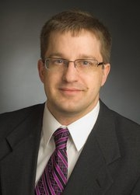
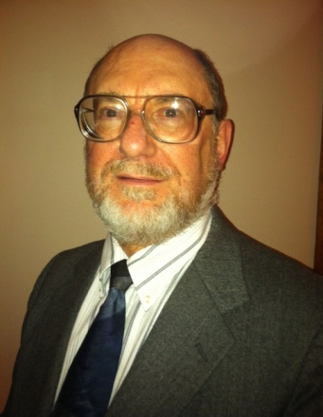
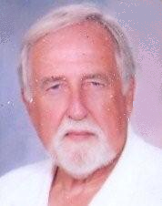
Mayo Clinic Team Members
McCarthy, M.D.
Hocum,
P.A-C
Steensma, M.D.
Dingli, M.D., PhD.
Gudgell, Admin
AMG Team Members
J. Rogers
E. Gallaher, PhD.
R. Chrisope
M. Diez
K. Rogers

Slide 4
Chronic Kidney Disease, Hemodialysis, and Anemia
Chronic Kidney Disease (CKD): Any disease that leads to a permanent loss of kidney function.
End Stage Renal Disease (ESRD): a complete/near complete failure of the kidneys to function normally.
Hemodialysis (HD): One of several treatment options for CKD.
90% of HD patients require Erythropoietic Stimulating Agents (ESA) to Prevent and Control the Anemia of CKD.

Slide 5
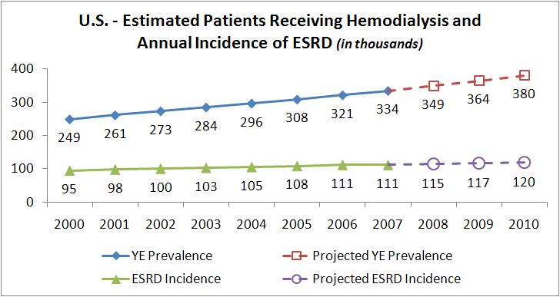
Scratchpad note:
406,000 Dialysis Patients in 2011 x $30,000 per patient = $12.2B /Yr.

Slide 6
Terms
Hemoglobin
The Protein that Enables Transport of Oxygen to the Body and Carbon Dioxide from the Body to the Lungs
Erythropoiesis
Greek: Erythro (“Red”) + Poiesis (“Making”)
Erythropoietic Stimulating Agent (ESA)
A Class of Drugs Designed to Replace Erythropoietin
Apoptosis
Greek: “Falling Leaves”
Refers to Programmed Cell Death

Slide 7
Anemia Among Dialysis Patients
A Significant Quality of Life Issue for HD Patients
Loss of appetite
Sleep disturbances
Decreased exercise tolerance
Inability to concentrate
Generalized weakness or malaise, body aches
Lightheadedness, dizziness, fainting
ESA and Iron Replacement Therapy Can Effectively Treat Anemia.
However, Current Protocols do not Address “System as Cause” Issues.

Slide 8
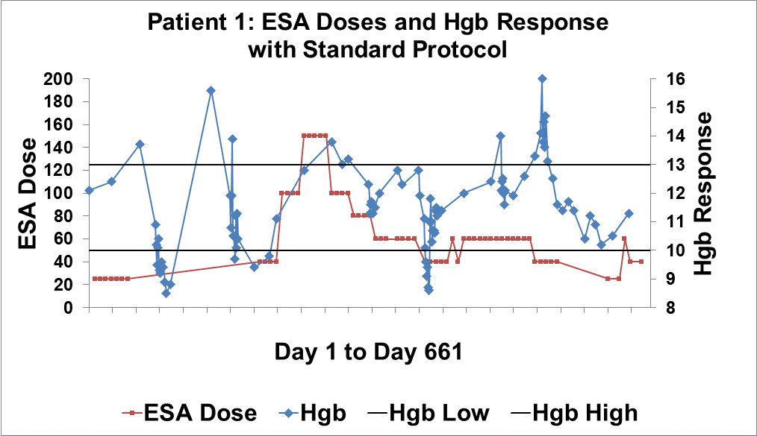

Slide 9
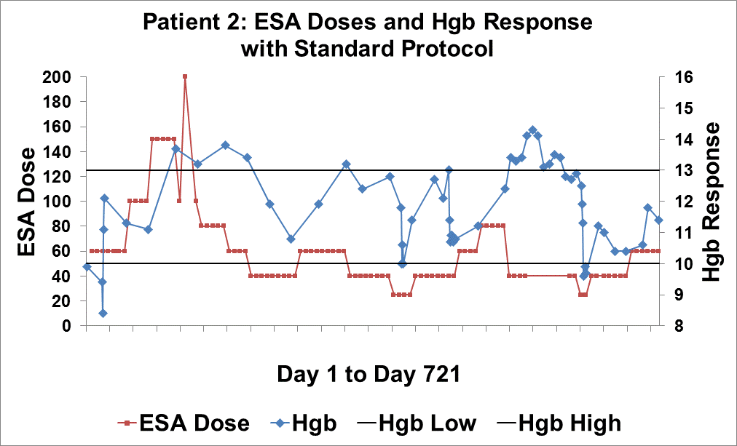

Slide 10
The Purpose of the Model: Find ESA Dosing Regimens That Stabilize a Patient’s Hgb in the Center of the Target Range
Hgb Too High: Cardiovascular Damage, Thrombosis
> 13
Target Range
Cyclic Period
Typically
6-9 Months
BTW
10-13
Hgb
Hgb Too Low: Anemic
< 10
Months

Slide 11
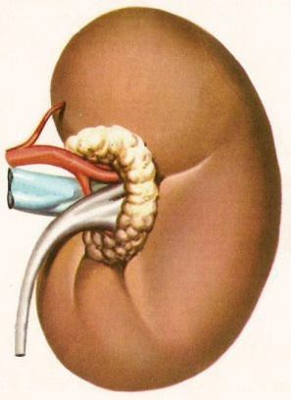
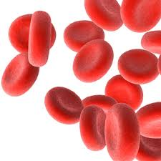
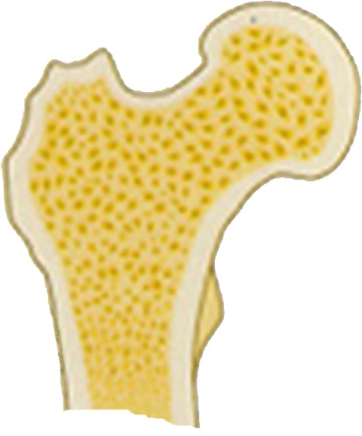
Regulating The Rate of Erythropoiesis
Normal Blood O₂ Level
B_{N}
Increased
O₂ Carrying Capacity
O₂ Deficit
ESA Therapy
15-20 Day
Delay
B_{Ex}
Decreased
RBC Progenitor
Apoptosis
Increased
Erythropoietin

Slide 12
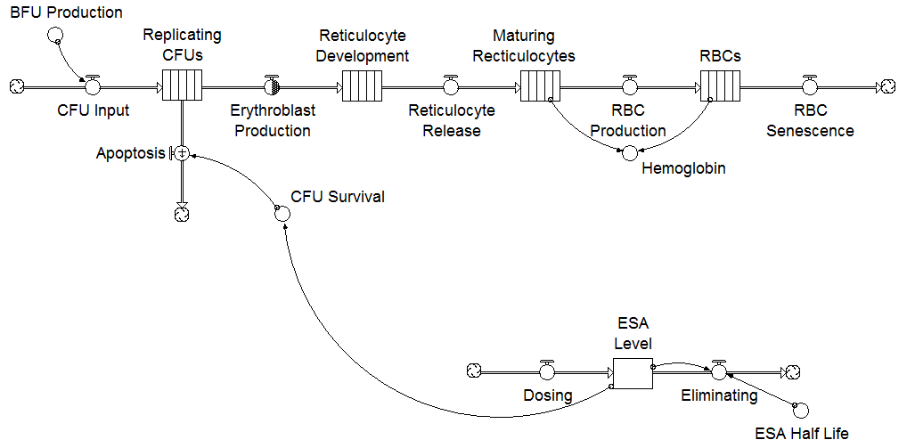
Concept Map of Major Stocks and Flows of Erythropoiesis
Bone Marrow
Circulation
Feedback goes through here!
BFU: Blast Forming Unit
CFU: Colony Forming Unit

Slide 13
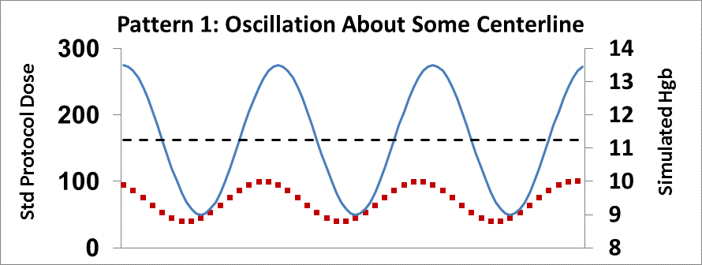
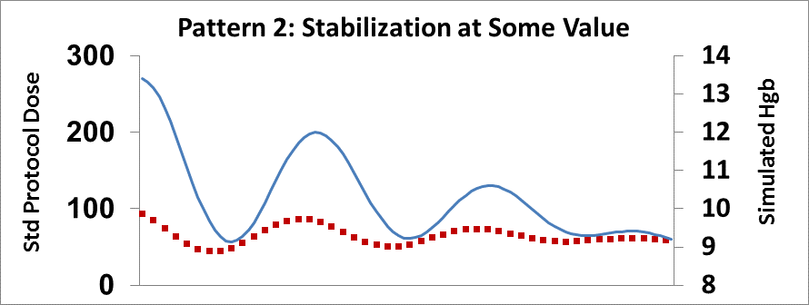
Simulation of Hgb Response to Standard Protocol Dose Prescriptions

Slide 14
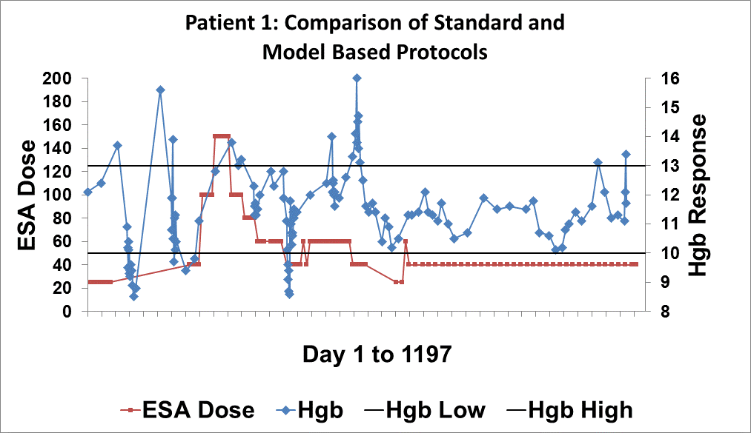
D. 675
Standard Protocol
Model Based Protocol

Slide 15
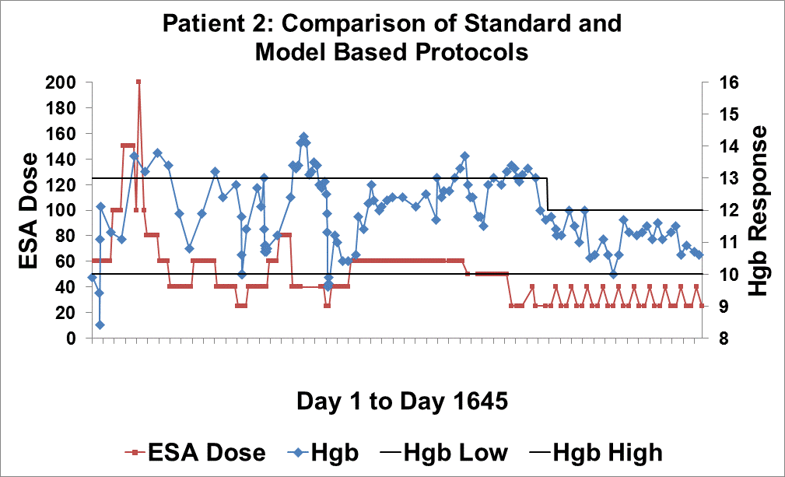
D. 722
Standard Protocol
Model Based Protocol

Slide 16
Mayo Clinic Dialysis Services (MCDS)
An Academic, Non-profit Institution
Service Arm of Mayo Clinic Department of Nephrology and Hypertension
17 Dialysis Care Facilities
625-650 Prevalent Hemodialysis Patients
15 Physicians; 7 Allied Staff - 2 PAs, 2 NPs, 3 RNs
Common Policies & Procedures
Shared Dialysis Database

Slide 17
Implementation Timeline
Milestone | Date
Model Version 1 Complete | 2Q 2008
Two Pilot Studies Complete | 3Q-4Q 2008
Anemia Management Software Application in Place | 4Q 2008
Organization-Wide Rollout Complete | 2Q 2009
Narrowed Target Hgb Range from 10-13 to 10-12 | 2Q 2010
Model Version 2 Complete | 1Q 2011

Slide 18
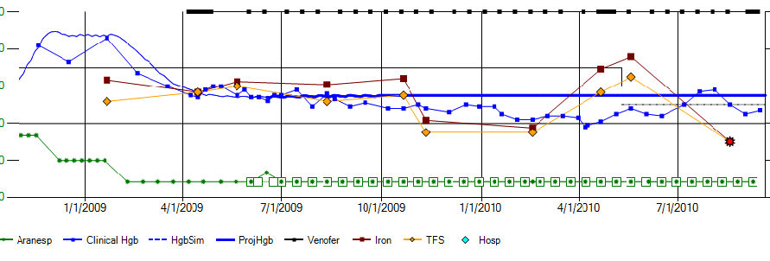
Sample Interactive BOT Chart
Q1
Q2
Q3
Q4
Q5
Q6
Q7
Simulated
Historical Hgb
Actual Hgb
Projected Hgb
Actual Iron
Dose
Iron
TFS
Recommended
ESA Dose
Actual ESA Dose

Slide 19
Improvements
Patient Quality of Life
Staff Productivity
Cost Reductions
First Pass at a Generalized Methodology for Biophysical System Dynamics

Slide 20
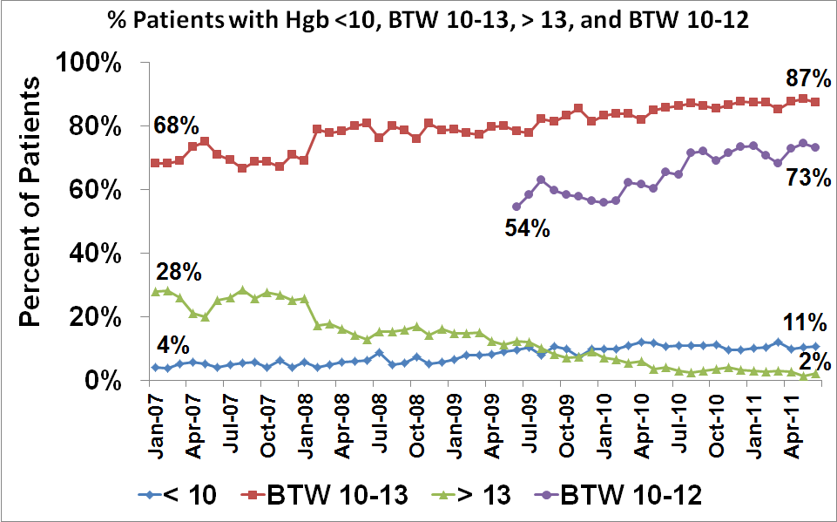
Interventions Begin

Slide 21
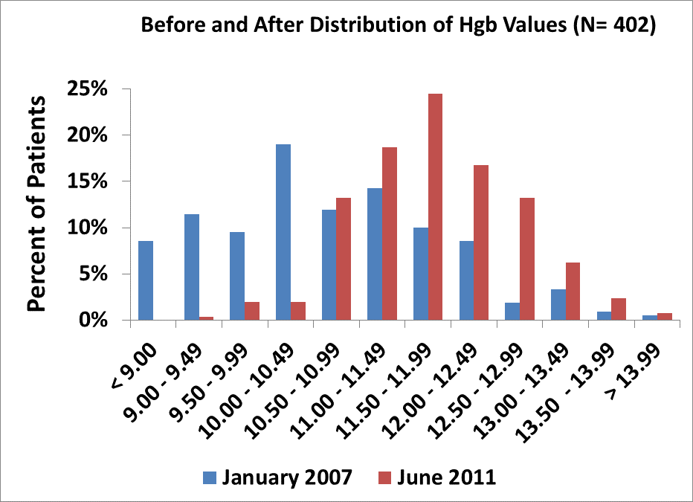
New Target Range
Target Range

Slide 22
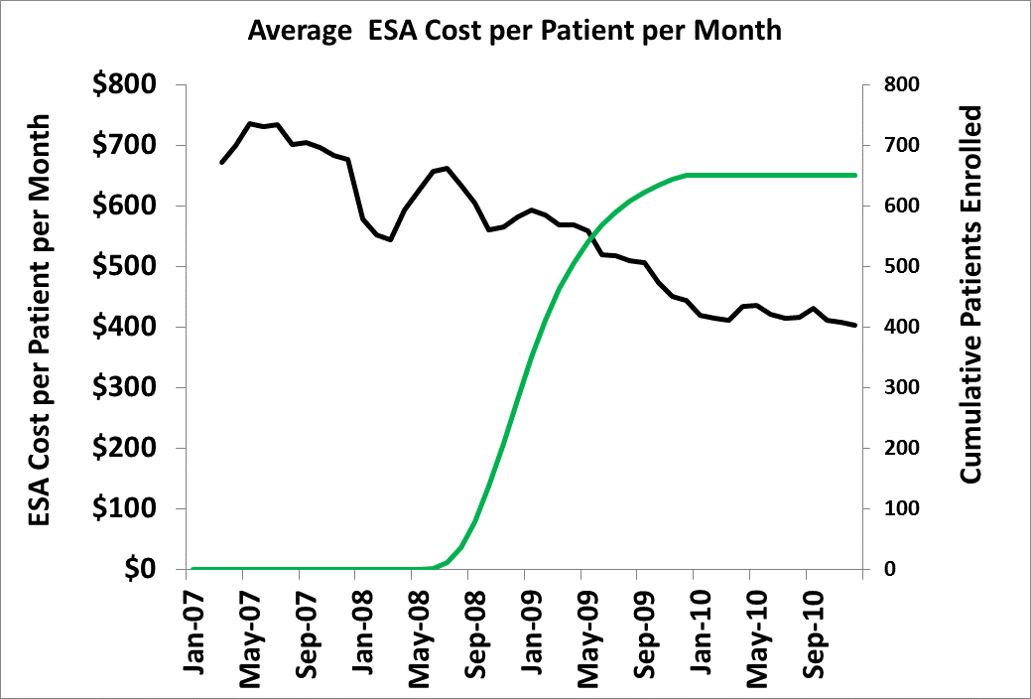
$700+
650
$400
Dec-10

Slide 23
Observed Reductions in Hospitalizations
(Currently Under Study)
Measurement | Before | After | % Change
Discharges per Patient Year | 3.14 | 2.28 | -27%
Days Hospitalized per Patient Year | 12.2 | 8.52 | -30%

Slide 24
Physician Perceptions of the Extensibility of Biophysical Modeling
“… applies to all of medicine.”
“… could revolutionize medical care.”
“… asks exactly the right questions … which are not being asked in medical schools.”
“… effectively addresses a fundamental issue at the core of medical care: homeostasis.”
“Places us in grave danger of actually learning something!”

Slide 25
Future Work
Extensions to the Erythropoietic Model
Methadone dosing learning environment
Other areas:
Antibiotics
Immunosuppressants
Anticoagulants
Collaboration with Emerging “Departments of Systems Biology”
Biophysical System Dynamics SIG

Slide 26
Three Messages
Management of Anemia is a Critical Issue for 90% of Dialysis Patients
System Dynamics Modeling Helped Redefine and Solve this Problem in Clinical Practice at Mayo Clinic
System Dynamics Modeling Provides Tools for Learning in the Emerging World of Individualized Medicine

